Slide 1
Information Technology Institute (ITI)
Virtual Office Management
Session 4 & 5 - Excel
ITI 490 Virtual Office Management - with Microsoft 365
(formerly Office 365)
Notes:
CANNOT EDIT PURPLE SHAPES OR LOGO
DIVIDER LINE IS EDITABLE
TO CHANGE IMAGE, RIGHT CLICK IMAGE, SELECT “CUT” TO REMOVE EXISTING IMAGE, AND CLICK IMAGE ICON TO INSERT NEW IMAGE
IF NO IMAGE IS IN PLACE, CLICK IMAGE ICON TO INSERT IMAGE

Slide 2
Excel

Slide 3
Class Outline
Session 4 – Excel Part I
Session 5 – Excel Part II
Introduction
Getting Started with Excel
Entering Data
Formulas and Functions
Formatting
Adjusting Worksheet Layout & Data
Adjusting Page Layout & Printing
Charting
Adjusting Worksheet Views
Multiple Worksheets and Workbooks
Data Management Features
Security and Sharing

Slide 4
Getting Started with Excel
What is Excel used for?
The Ribbon and Quick Access Menu
Shortcut menu and the Mini Toolbar
Understanding Workbooks and Worksheets
Use Excel Help
Accessibility Features
01 - Examples.xlsx

Slide 5
Entering Data
Explloring Data Entry, Editing and Autofill
Working with Dates and Times
Using Undo and Redo
Suae Save and Save As
02 - Entering Data.xlsx

Slide 6
Formulas and Functions
Using Simple Formulas
Copying a formula into an adjacent Cell
Using SUM and AVERAGE
XLOOKUP and lookup functions
03 - Creating Formulas and Functions.xlsx

Slide 7
Formatting
Exploring Fonts and Styles
Color Backgrounds
Adjusting Row Height and Column Widths
Applying Number Formats
04 - Formatting.xlsx

Slide 8
Adjusting Worksheet Layout & Data
Row and Column Insert, Delete, Hide and Unhide
Moving Copying and Inserting Data
Finding and Replacing Data
05 - Layout.xlsx

Slide 9
Adjusting Page Layout & Printing
Page Layout View and Commands
Using Pae Break Previews and Print Setup Options
06 - Printing.xlsx

Slide 10
Charts
Creating Charts
Exploring Chart Types
07 - Charting.xlsx

Slide 11
Multiple Worksheets and Workbooks
Renaming, Inserting, and Deleting Sheets
Moving, Copying, and Grouping Sheets
Opening, Closing, and Saving Workbooks
08 - Worksheet Views.xlsx
09 - Multiple Worksheets.xlsx

Slide 12
Data Management Features
Sorting Data
Using Filters
Creating PivotTables
10 - Data Management Features.xlsx

Slide 13
Security and Sharing
Protecting Worksheets and Workbooks
Sharing Workbooks and Tracking Changes
11 - Protection.xlsx
11-Vendor Sales 2022.xlsx

Slide 14
Getting Started with Microsoft Excel
Navigate the Excel User Interface
Use Excel Commands
Create and Save a Basic Workbook
Navigate in Excel for the Web
Enter Cell Data
Use Excel Help

Slide 15
Navigate The Excel User interface

Slide 16
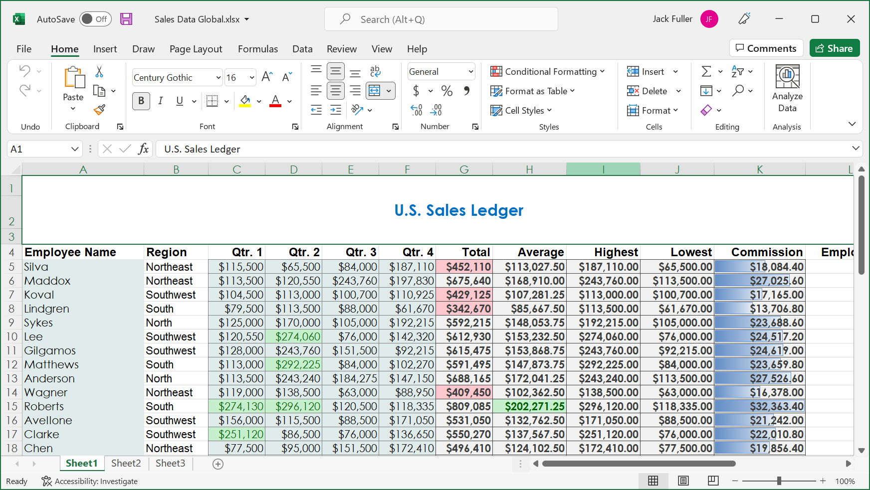
Microsoft Excel
Notes:
Will be working with a ribbon again; looks very similar to what we saw in Word. Will be working with Command Groups & Tabs. But what was previously our documents area is now our tables/charts, etc.
What do we use Excel for? Budgets, Attendance Sheets/Rosters, Calendars, Financial/Accounting Data of all kinds

Slide 17
The Ribbon
Tabs
Groups
Dialog box launcher
Commands
Notes:
Will be working with a ribbon again; looks very similar to what we saw in Word. Will be working with Command Groups & Tabs. But what was previously our documents area is now our tables/charts, etc.
What do we use Excel for? Budgets, Attendance Sheets/Rosters, Calendars, Financial/Accounting Data of all kinds

Slide 18
The Ribbon Tabs
Ribbon Tab | Contains Commands For
File | Working with your Excel files and configuring system-wide and application settings and options.
Home | Executing some of the most common Excel tasks such as basic text formatting and editing; applying various styles and formatting to the data; and sorting, filtering, and searching data.
Insert | Inserting a variety of objects, such as charts, tables, and graphics, into your workbooks; creating and editing hyperlinks; adding headers and footers to worksheets; and inserting equations and symbols.
Draw | Adding notes, creating shapes, and editing text using mouse, digital pen, or touchscreen.
Page Layout | Applying themes and effects to worksheets; configuring the overall layout of your worksheets; and arranging worksheet objects.
Formulas | Inserting and working with formulas and functions; naming cells and ranges; troubleshooting workbook data, functions, and formulas; and setting calculation options.
Data | Importing data from other sources; performing various data analysis tasks; and organizing worksheet data into a hierarchical structure.
Review | Reviewing, proofing, adding comments to, and sharing your workbooks.
View | Configuring workbook views, viewing multiple workbooks simultaneously, and setting the magnification level.
Help | Searching the documentation, contacting support, providing feedback, suggesting a feature, and accessing Microsoft resources.

Slide 19
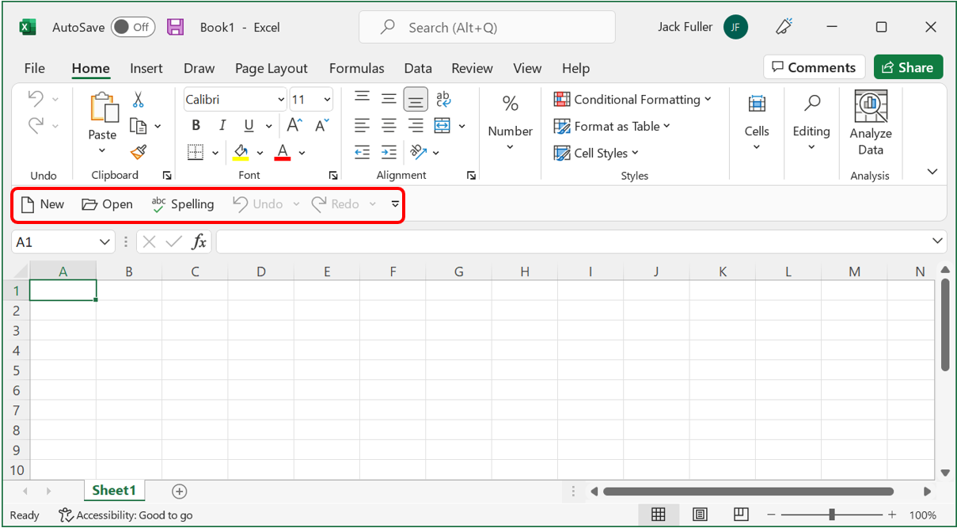
Quick Access Toolbar

Slide 20
Spreadsheets, Worksheets, and Workbooks

Slide 21
Spreadsheets, Worksheets, & Workbooks
Spreadsheet: a paper or an electronic document, arranged in tabular form, that is used to store, manipulate, and analyze data
Worksheet: an electronic spreadsheet that is used for entering, storing, and analyzing data in Excel
Workbook: an Excel file that serves as a container to store related Excel worksheets

Slide 22
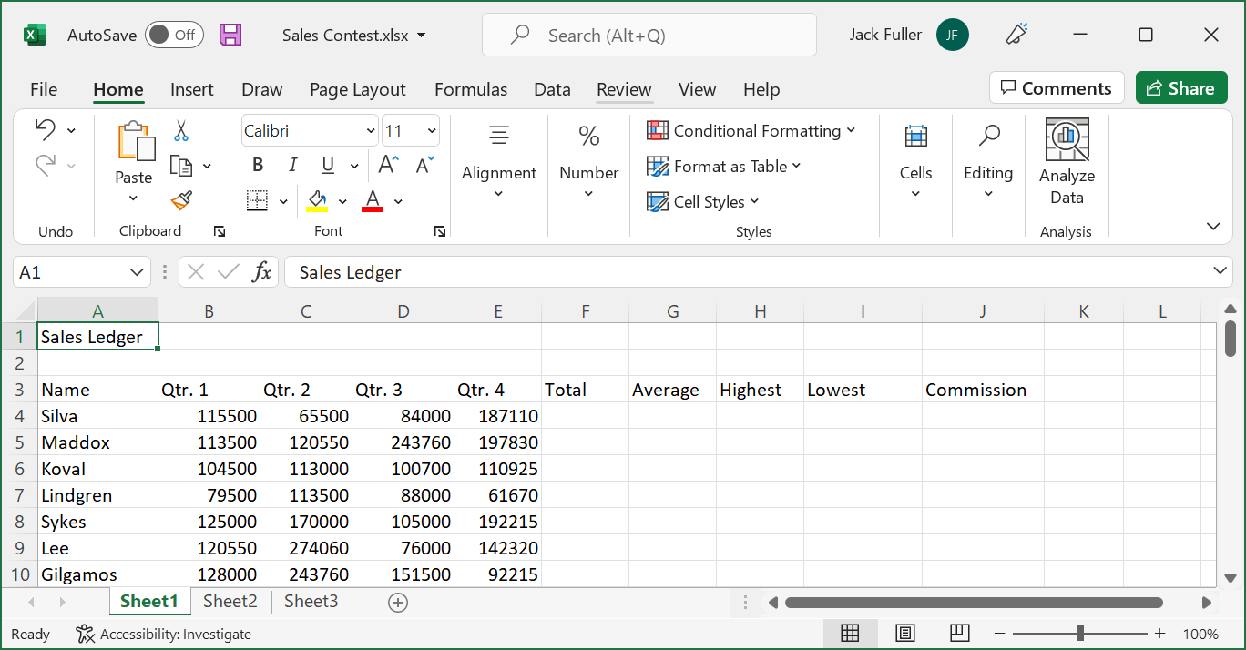
Spreadsheets, Worksheets, & Workbooks
Workbook
Worksheets in the workbook
Worksheet
Notes:
We have the name of the workbook (the name of the file) at the top (just like we saw in Word). Notice the new extension (.xlsx); in Word we had the .docx file extension. For Excel it’s .xlsx (older versions might be .csv).
Worksheets are essentially like pages, divided into Tabs. Each sheet is a new table in Excel but part of the same Workbook (or file) as a whole.

Slide 23
Cells and Ranges
Cell: A singular container that you can use to input and store data
Range: A contiguous group of cells that typically contains related data
Cell
Range
Notes:
Essential vocabulary: Cells & Ranges
When we refer to a specific box on the table (notice in Excel it looks like a grid; might remind you of graphing paper from math class in school).
These boxes are called CELLS
Groups of Cells are referred to as a RANGE.
How do we refer to cells? This is what is called CELL REFERENCE. Our Coordinate System.

Slide 24
Cell and Range References
Cell reference: Consists of a column header and a row header, which identify the cell at the intersection of the column and the row
Range reference: Consists of two cell references, separated by a colon, that represent cells at the top-left and bottom-right in the range
Column headers
Row headers
Cell B6
Range D2:F6
Notes:
Excel is essentially a coordinate system; remember the –X and –Y axis in math class? We refer to the X-axis first and then the Y-axis.
For Excel this translates to Column 1st and Row 2nd. Ex: Cell B6
All Excel files follow this system. {Point out different cells to the class to name}

Slide 25
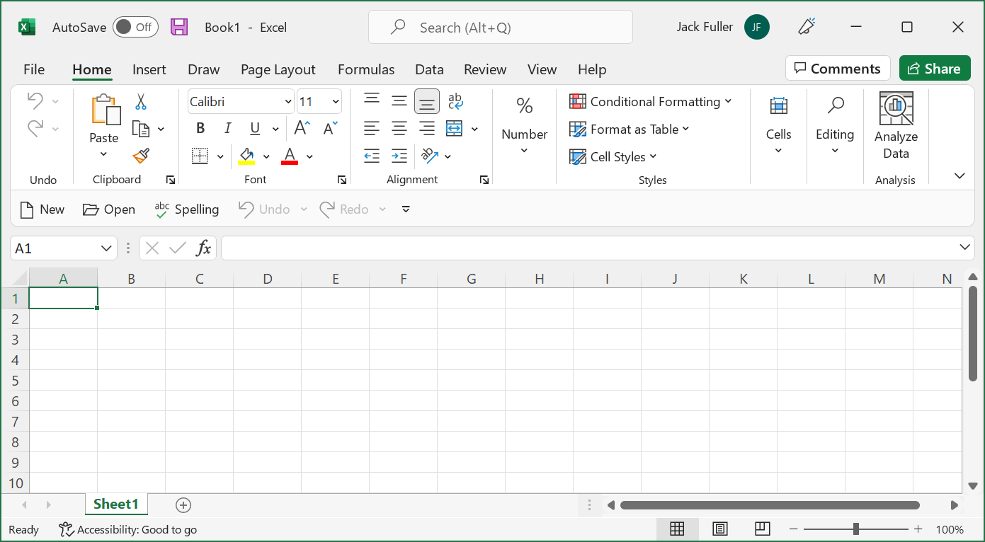
The General Excel User Interface
Account icon
Upcoming Features. Try It Now.
Title bar
Share button
Comments button
Ribbon
Ribbon Display Options button
Quick Access Toolbar
Status bar
Accessibility Checker
View and zoom controls
Notes:
Most important thing here is to notice the interface is very similar to Word. But instead of a document we have a spreadsheet workbook.

Slide 26
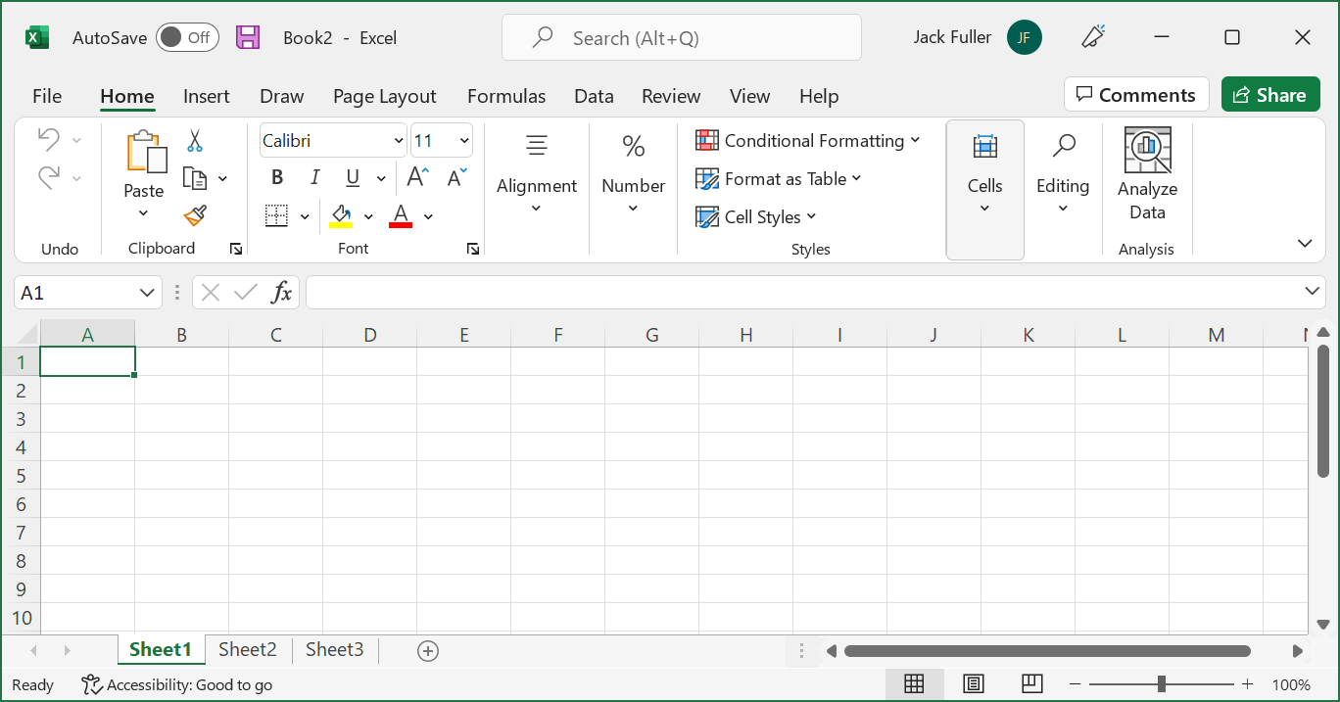
Workbook & Worksheet Elements
Name Box
Formula Bar
Select All button
Column headers
Scroll bars
Row headers
Worksheet tabs
Worksheet tab navigation controls
New sheet button
Notes:
Mainly want to focus on the areas that are different than what we saw in Word.
NAME BOX: The Name Box will give you the coordinates for the cell that you are currently editing. The cell you are editing is known as the ACTIVE CELL. It has a green border around it. You can see this in Cell A1 right now. If you type a cell reference in the Name Box you will be brought to that exact cell (Ex: If you type D8 you will be brought to that cell on the worksheet; it is now your Active Cell).
FORMULA BAR: Yes, this bar will be used for formulas (which we’ll do later to have Excel perform math functions for us), but it is also where we can type information/data. Sometimes the cell isn’t large enough to display everything; using the Formula Bar can make your life easier.

Slide 27
Entering Cell Data

Slide 28
The Active Cell
Active Cell
Displayed with a solid green border
Only one active cell when you select a range
Displayed without a shaded background

Slide 29
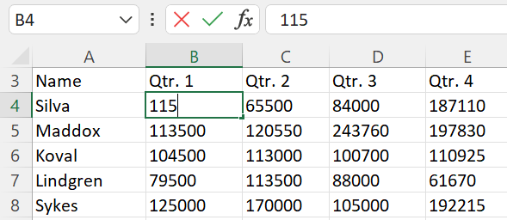
Data Entry: Name Box, Active Cell, Formula Bar
Name Box
Formula Bar
Data being entered

Slide 30
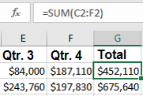
It’s Not WYSIWYG (What You See Is What You Get)
You can always see the actual data within a cell by looking at the Formula Bar
It may look like a simple number, but it could actually be a complex formula
What’s actually in the cell
What appears in the cell

Slide 31
Mouse & Keyboard navigation in Excel

Slide 32
Mouse Navigation and Data Selection
Navigation Option | Mouse Command
Select a particular cell. | Select the desired cell.
Select a range of cells. | Click and drag to select the desired range of cells.
Select an entire column or row. | Select the desired column or row header.
Move the worksheet display up or down by a single row. | Select one of the vertical scroll arrows.
Move the worksheet display left or right by a single column. | Select one of the horizontal scroll arrows.
Move the worksheet display by more than one row or column at a time. | Click and drag the vertical or horizontal scroll bars to the desired view.
Move the worksheet display one screen at a time. | On the vertical scroll bar, select the area between the scroll bar and the desired direction's scroll arrow.
Display a different worksheet. | Select the desired worksheet tab along the bottom of the workbook window.

Slide 33
Mouse Cursor Icons
Icon | Cursor Context/Location | Description
 | Placed on ribbon tabs or commands, Backstage tabs or commands, Quick Access Toolbar commands, scroll bars, sheet tabs and navigation commands, and view and zoom controls. | Select an element to perform the associated action.
 | Placed at any edge of a cell or range of cells. | Drag a cell or range of cells to move the data inside to another cell or range.
 | Placed over a cell in a worksheet. | Select an individual cell, or drag to select a range of cells.
 | Placed between worksheet column headers. | Resize the column to the left of the cursor, or double-click to AutoFit the column to the left of the cursor.
 | Placed between worksheet row headers. | Resize the row above the cursor, or double-click to AutoFit the column above the cursor.
 | Placed inside an active cell, the Formula Bar, or various text boxes. | Select inside a text box or the Formula Bar to begin typing data into it. Or, double-click an active cell to do likewise.
 | Placed at the bottom-right corner of a cell or range of cells. | Drag vertically or horizontally to copy or AutoFill data into adjacent cells.

Slide 34
Keyboard Navigation
Navigation Option | Keyboard Command
Move one cell up, down, left, or right from current cell. | Press the Up, Down, Left, or Right arrow key.
Move to the cell in column A of the current row. | Press the Home key.
Move to the first or last column or row of data. | Press and hold down the Ctrl key, and then press the Up, Down, Left, or Right arrow key.
Scroll up or down by one screen. | Press the Page Up or the Page Down key.
Scroll left or right by one screen. | Press Alt+Page Up or Alt+Page Down.
Move one cell to the right. | Press the Tab key. This will also enter data into the cell.
Move one cell to the left. | Press Shift+Tab.
Move one cell down. | Press the Enter key. This will also enter data into the cell. To enter data without navigating away, press Ctrl+Enter.
Move one cell up. | Press Shift+Enter.
Move to cell A1. | Press Ctrl+Home.
Navigate through the worksheets in a workbook. | Press Ctrl+Page Up or Ctrl+Page Down.

Slide 35
Keyboard Data Selection
Selection Option | Keyboard Command
Select the entire worksheet. | Ctrl+A
Select cells in a column one by one, starting with the active cell. | Shift+Up Arrow or Shift+Down Arrow
Select cells in a row one by one, starting with the active cell. | Shift+Right Arrow or Shift+Left Arrow
Select all contiguously populated cells in a column from the selected cell to the end of the range. | Ctrl+Shift+Up Arrow or Ctrl+Shift+Down Arrow
Select all contiguously populated cells in a row from the selected cell to the end of the range. | Ctrl+Shift+Right Arrow or Ctrl+Shift+Left Arrow

Slide 36
Calculations

Slide 37
A Basic Mathematical Formula
Result
Expression
Variable
Constant
Operator
Notes:
Why are we talking about this? Excel works with variables as well.
Instead of ‘X’ in our case we will be using our Cell References. This is how we write a formula in Algebra; let’s take a look at how we’ll write a formula in Excel.

Slide 38
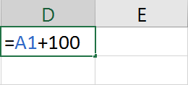
Elements of Excel Formulas
Constants: The numbers and text in a formula that do not change unless manually altered.
References: The cell or range references that Excel uses as value(s) to perform the calculations in a formula.
Mathematical operators: Symbols that specify the kind of calculation that Excel should perform on the elements of a formula.
Constant
Operator
Equal sign
Reference
Notes:
This is an example of a mathematical operation in Excel. Keep this impression in your mind. We all forget to do this, but the first thing you ALWAYS want to do when entering a formula is use the ‘=‘ sign. If you forget it, your formula won’t work.
What is this one saying? It means that value that is in A1 is equal to that value plus 100. So, if A1 has a value of 5 what would be the value in this cell? Constants are what you manually enter. If not using a constant, there would be a cell reference. Then there is a mathematical operator.
In an Excel formula you will have you Equal Sign, any Constants or References, and the Operator (in this example the ‘+’ sign, thus the operator will be performing addition)

Slide 39
Order of Operations

Slide 40
The Order of Operations
Order of operations:
Parentheses
Exponents
Multiplication and Division
Addition and Subtraction
If two operations are at the same order of preference, Excel reads left to right.
Second highest precedence
Third highest precedence
=(A2+B2)^2-10*C2
Highest precedence
Lowest precedence
Notes:
Exponents in Excel are with the caret symbol ‘^’
Multiplication is done with the asterisk symbol ‘*’

Slide 41
Order of Operations: PEMDAS A helpful Mnemonic Device
Please Excuse My Dear Aunt Sally
Parenthesis
Exponents
Multiplication
Division
Addition
Subtraction

Slide 42
Functions

Slide 43
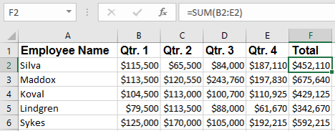
Functions
Functions: Built-in, pre-existing formulas users can insert into Excel worksheets.
Arguments: Elements of Excel functions that define the values and references the function will use to perform a particular calculation.
SUM function
Argument
Function result
Notes:
Most common is Auto-Sum
You don’t have to memorize keywords for this; Excel does a good job of doing this for you

Slide 44
The Function Library Group
Function categories
Notes:
Some of the common categories here. Functions aren’t simply about mathematical calculations. There are 100s of these.
I’ve only used about 5 or 6 of them. How many you would actually use will depend heavily on the type of work that you do. Some positions require little, some (such as accounting) may require a lot.

Slide 45
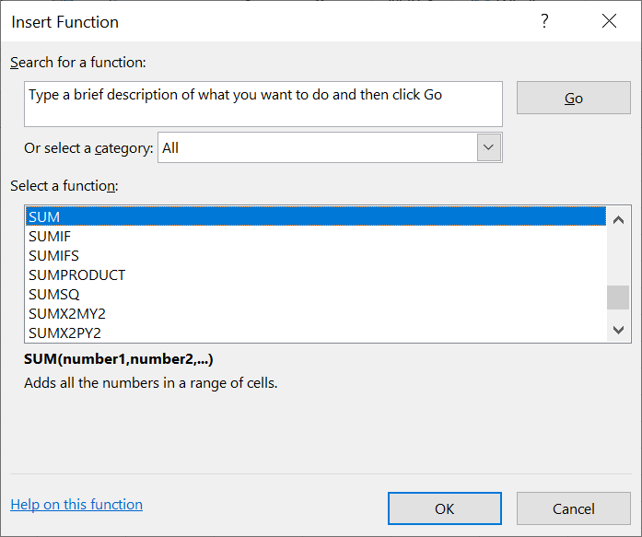
The Insert Function Dialog Box
Function description

Slide 46
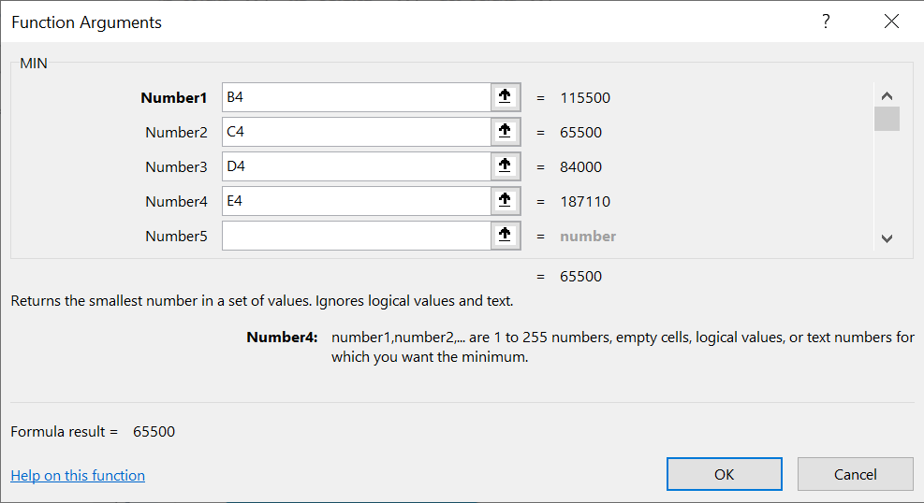
The Function Arguments Dialog Box
Collapse Dialog buttons
Required argument
Optional arguments
Function description
Formula result
Argument description

